Slide 1
Level 4/5 Group 18
Blake Hewitt, Elliot Dewhurst & Guy Zawada

Slide 2
What’s Our Idea?
Genre: Physics-Based, 2D, Sumo style, 1 on 1 arena game
Platform: Desktop PC for now…
Objective: Push your opponent off the arena

Slide 3
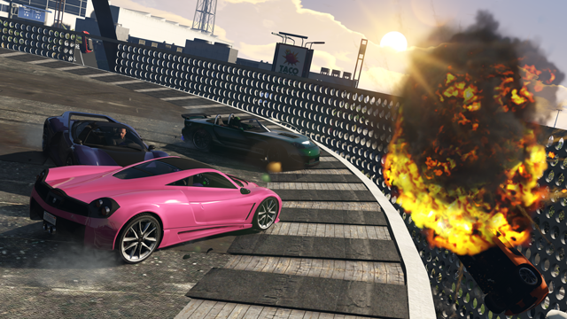
Inspirations for the idea
Sumo Cars – GTA V Multiplayer Minigame

Slide 4
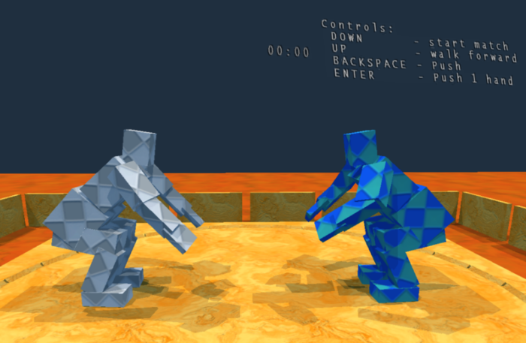
Inspirations for the idea
Sumotori
http://www.gravitysensation.com/sumotori/

Slide 5
Mechanics
Physics-based pushing
Boost Mechanic
Avoidance of opponent and obstacles
Awareness of round timer

Slide 6
Gameplay Demo

Slide 7
Design
Japanese-inspired theme
Simple Art Style
Quick-fire Rounds, multiple rounds per match
Strategic, risk and reward based power-up placement

Slide 8
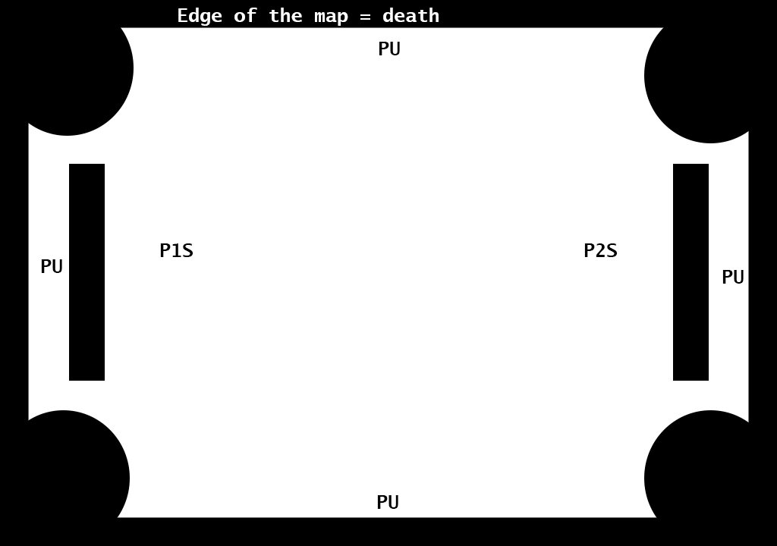
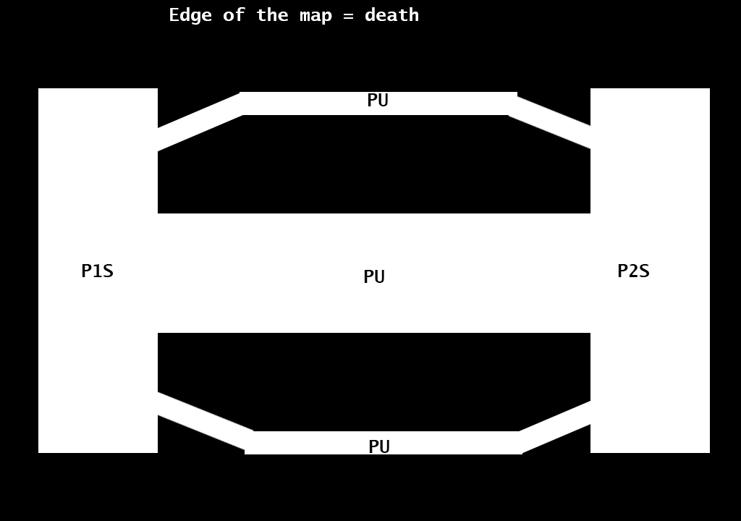
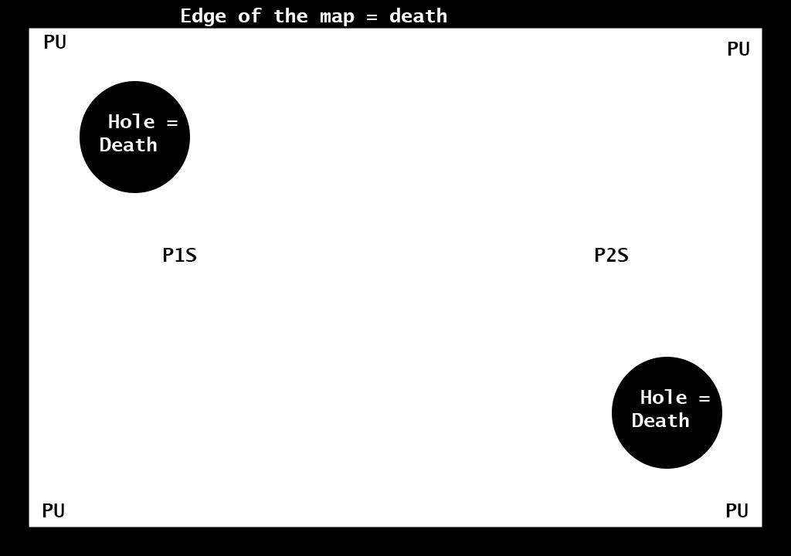
Level Designs

Slide 9
Level Design Details
Power Ups – Increase Mass, Increase Pushing Force, Increase Speed
Obstacles in the level
Random level for each round

Slide 10
UI/Screen Mock Up

Slide 11
Future/Stretch Goals
Based on playtesting feedback, in order of importance…
More Levels to choose from
Improve player character movement, make it less slide-based.
Fully decide the art style

Slide 12
Questions?

